Slide 1

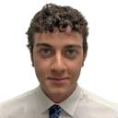
Co-Op Reflection
Summer 2025
Jackson Sammartino
RoviSys Building Technologies, GA Office
July 25, 2025

Slide 2

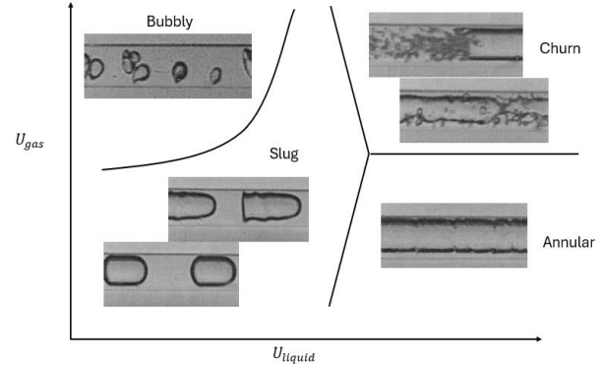
Who am I?
Grad student at UF, MS in mech. eng.
Specializing in FEM and mech. design
  Nonlinear structural design/optimization
Some HVAC/controls
Thermal/fluids research: 2-phase flow
2-phase flow regimes based on relative liquid/gas velocities

Slide 3
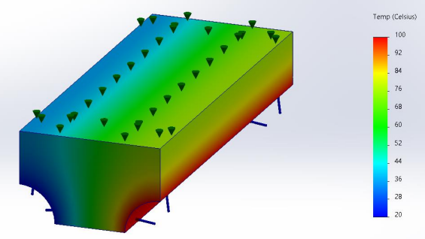
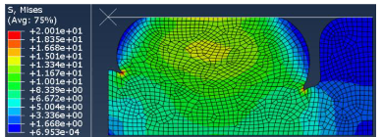
My Work
Very simple: linear FEA
Elastic materials
Easy to model and run
Possibly 100% accurate
Steady-state heat transfer in piping system
Much more complex: nonlinear FEA
Hyper/hypo-elastic materials
Permanent deformation, inelasticity
Computational and mental effort
Extreme compression of rubber (hyperelastic) material

Slide 4
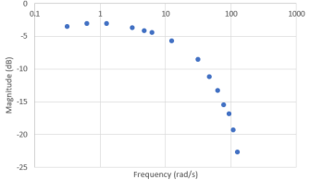
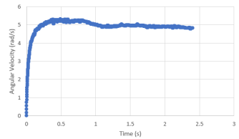
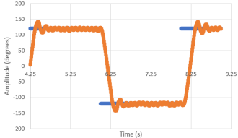
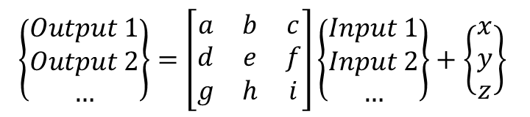
My Work (cont.)
Manual tuning,
PID
Input/output Bode plotting, transfer functions
Step/ramp response testing, transfer functions
$$\left\{\begin{matrix}Output 1 \\ Output 2 \\ …\end{matrix}\right\}=\left[\begin{matrix}a & b & c \\ d & e & f \\ g & h & i\end{matrix}\right]\left\{\begin{matrix}Input 1 \\ Input 2 \\ …\end{matrix}\right\}+\left\{\begin{matrix}x \\ y \\ z\end{matrix}\right\}$$
State-space modeling, LQR algorithms
Designed controller for desired system behavior

Slide 5
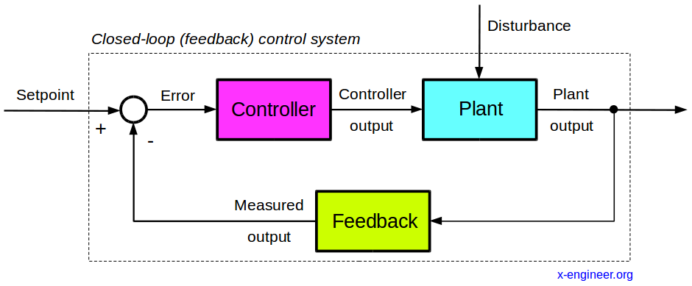
Expectations
Design
    System/controller design
    Modeling/simulation
Instrumentation
    Selection based on design reqs.
    Drawings: electrical, P&ID
    Procurement
3. On-Site Execution
    Installation/configuration
    Point-to-point checks
    Controller tuning
    Full system testing
General:
Controls engineering
Complete-ish project cycle
Occasional travel to site
$23 hourly
Heavy supervision
Some “intern work”

Slide 6
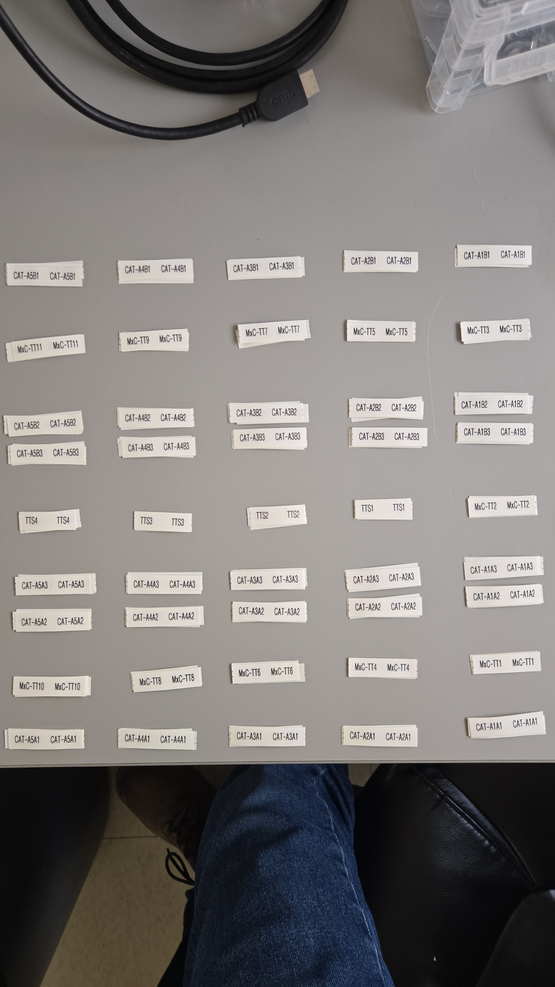
Reality
“Intern work”
1350 temperature sensor labels

Slide 7

… just kidding

Slide 8

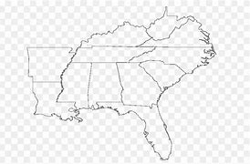
Reality: RBT
Full-time relocation to MS
Amazon data center campus
Entirely on-site execution phase
    P2P checks
    Sensor troubleshooting/wiring
    Full system testing
Worked with BMS team
Supported commissioning/testing
Trained new hires

Slide 9
JAN 102-104
Tank 4
Tank 3
Tank 2
Tank 1
Romp07 <<< Romp03
1.6 <<< 1.2
Romp01
1.1
Offices
IW Room
Romp02
2.1
Romp08 >>> Romp12
2.2 >>> 2.6
200’
1000’

Slide 10
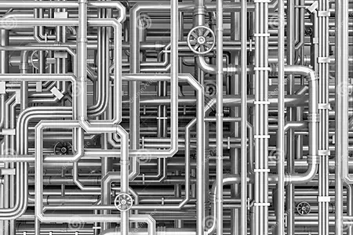
Industrial Water (IW) Room Overview
Tank 4
Tank 3
Tank 2
Tank 1
IW Room
Pressure sensors
Tank fill level detectors
Valves/actuators
Flowmeters/totalizers
Water conductivity probes
Leak detectors
Pump systems
Water oxidation treatment system

Slide 11
Romp Overview
Start/stop/status relays
Cooling modes relays
Temps.
Fan speeds
Leak detectors
DAHU Gallery-B
Row Supply Header-B
Dampers/actuators
Diff. pressures
Data Hall
4x Cold Aisles
2x Hot Aisles
Temps.
Dewpoints
Relative humidity
Diff. pressures
Row Supply Header-A
DAHU Gallery-A
Similar to DAHUs
Modbus chain
Exhaust Fans
Electrical Room
Panels: LOP, MCC, ACP, MxC
Heat pumps modbus chain

Slide 12
What I Loved
Independence and trust
NO “intern work”
Team environment
  General good vibes
  Great foods
  Best roommates I have had
Generous compensation
  Base hourly wage
  Additional hourly EOSP
  Overtime/weekend opportunities
  Mileage rate
  Per diem rate
  Housing covered
  Trailer loaded with loot
  Lots of expenses covered
  Travel weekends
  RAC events

Slide 13
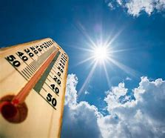
What I Did Not Expect
NO design: “not our scope”
Tech. work rather than eng. work
On-site bureaucracy obstacles
    AWS, electrical/mechanical contractors
    Never got data hall access
Mississippi [surprise!] summer heat

Slide 14
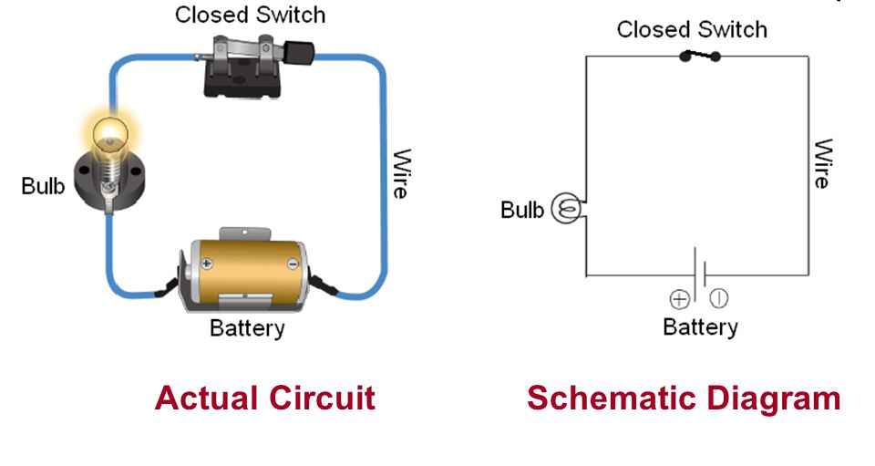
What I Learned (about engineering)
Translating between drawings/real life
Electrical/circuit components
Troubleshooting skills
Building systems integration
How computers communicate

Slide 15
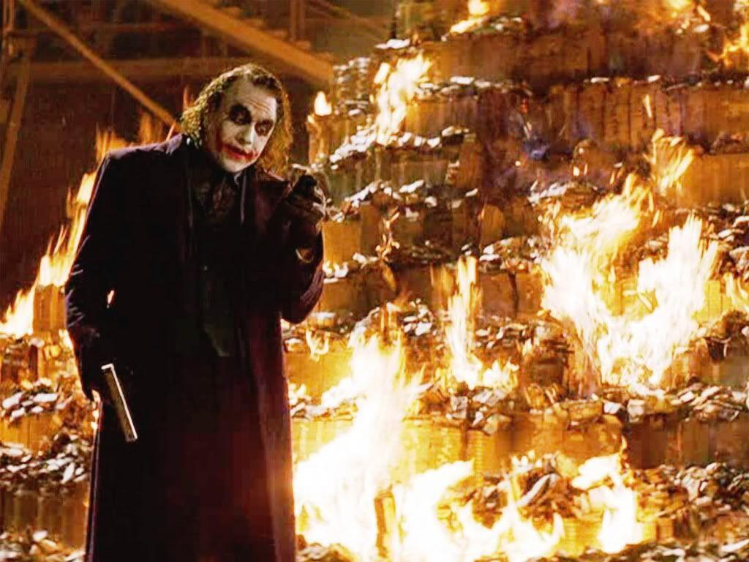
What I Learned (about life)
Money is not #1
Design is what I enjoy
Experience > fancy college degree
Collaboration/hierarchy/scope is an essential part of any job

Slide 16
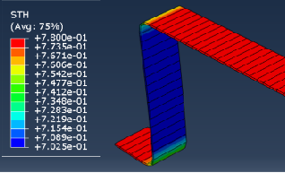
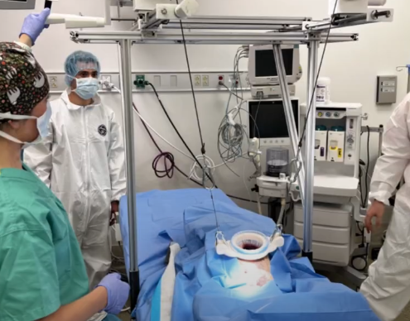
Future Plans
Sheet thickness profile in deep-drawing manufacturing
Do what I enjoy/am good at
  Design, simulation, testing
Earlier stages in the design process
Mechanical > electrical
More collab. with end-users
Collaborative testing with veterinarians

Slide 17
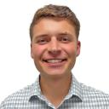
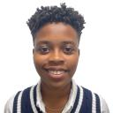
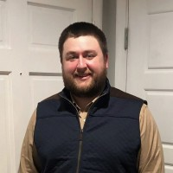
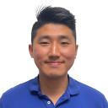
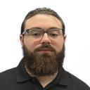
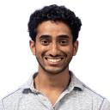
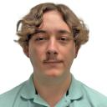
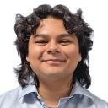
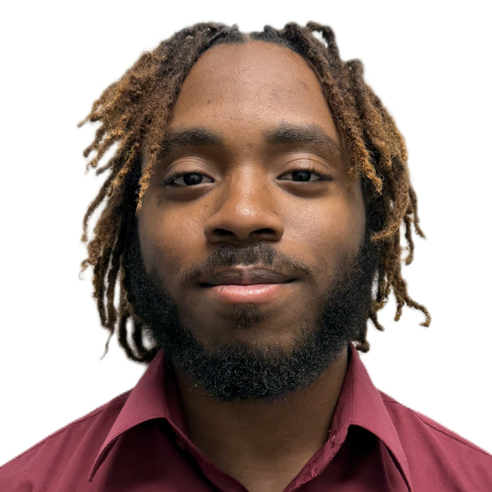
Acknowledgements
Grant Gleason
Savanna Johnson
Caswell Clark
Wongyu Han
Austin Swindle
Dharmin Patel
Jack Jones
Edwin Korzi-Dominguez
Reasun Allah-U-Akbar

Slide 18
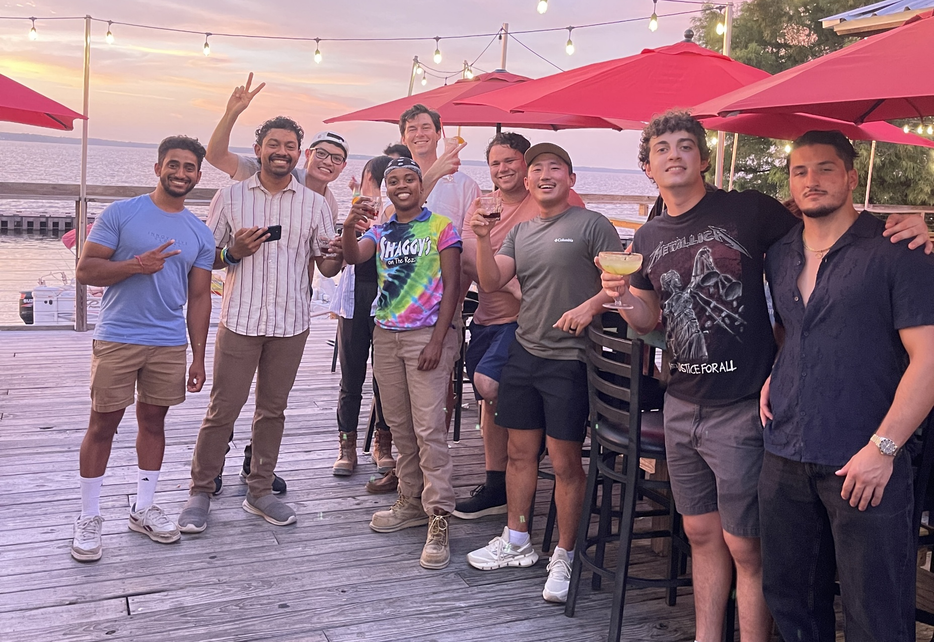
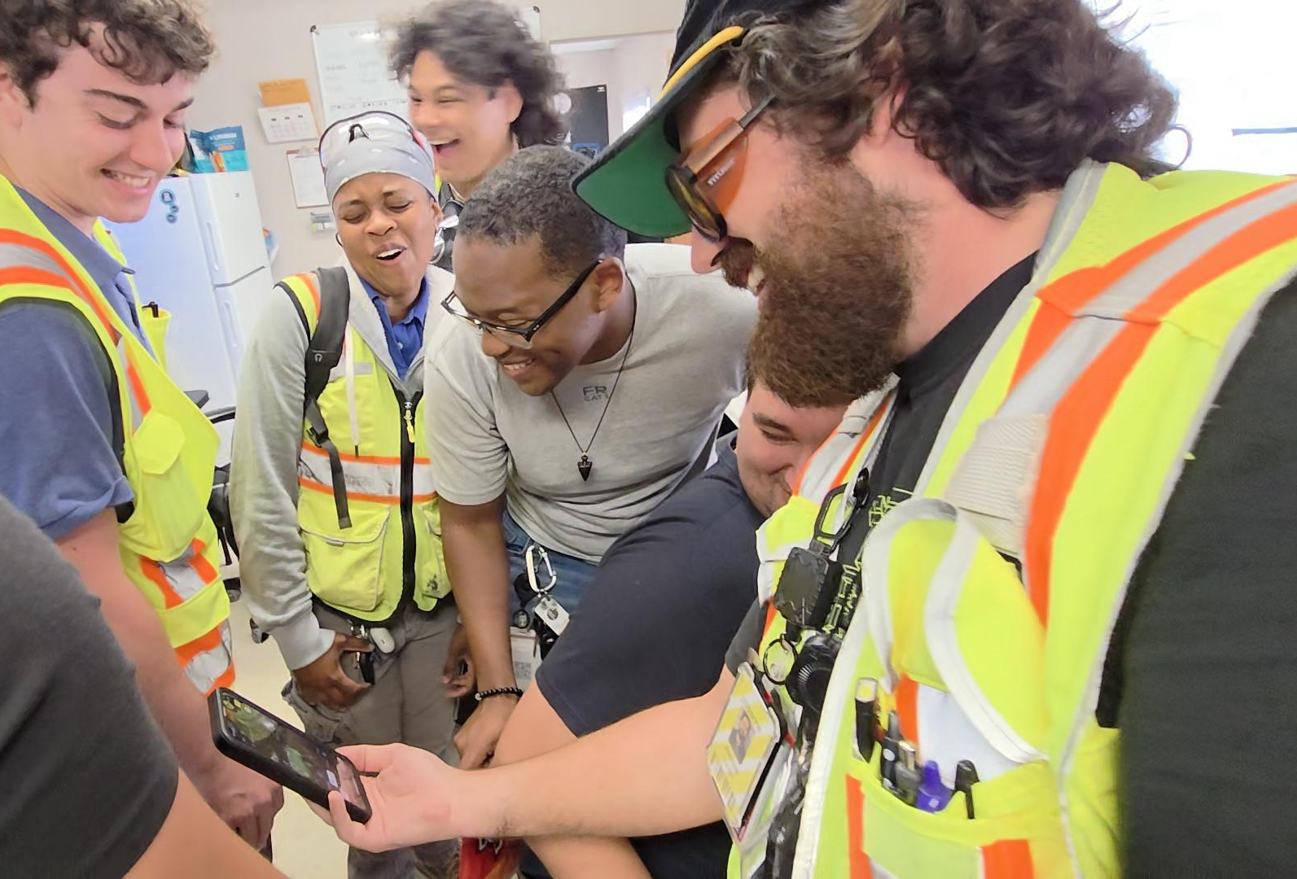
Acknowledgments (cont.)

Slide 19

Thank you!
Questions/comments?
My LinkedIn →
Nice idea, Jack!

